Slide 1
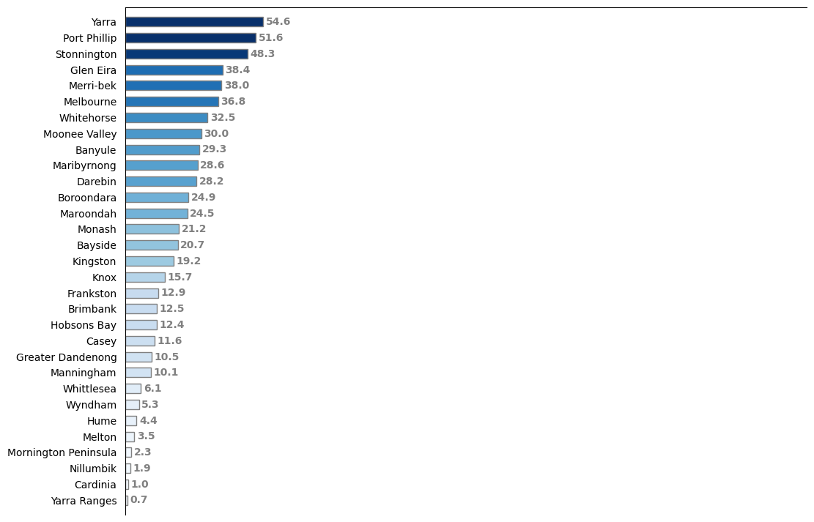
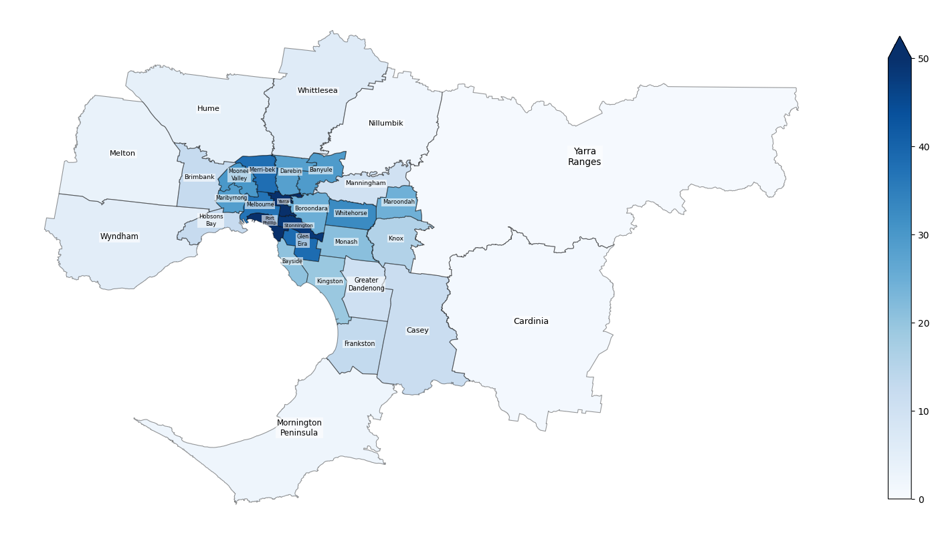
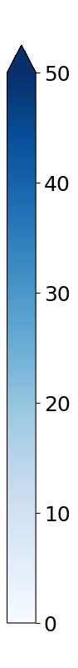
Where are the Nurses and Midwives residing in Greater Melbourne?
Local Government Areas
Density of nurses and midwives per km²
+
Density of nurses and midwives per km²
Data from ABS (Australian Bureau of Statistics) 2021 Census, aggregated at LGA (Local Government Areas) level

Slide 2
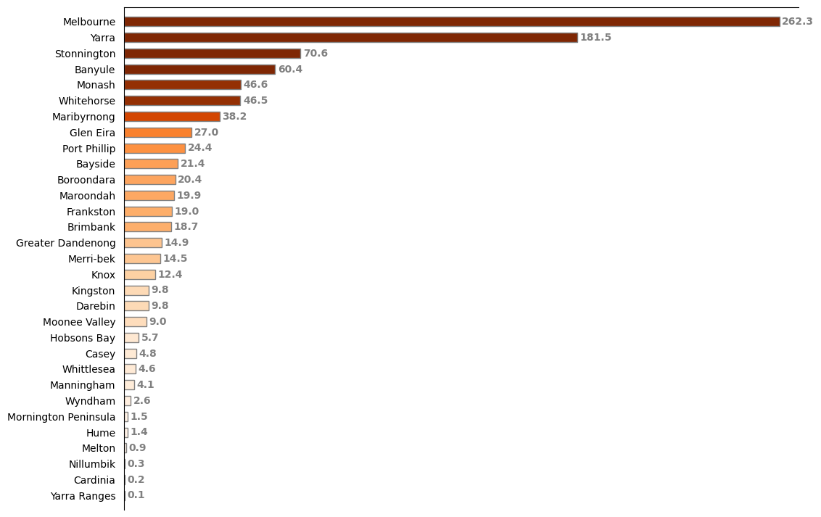
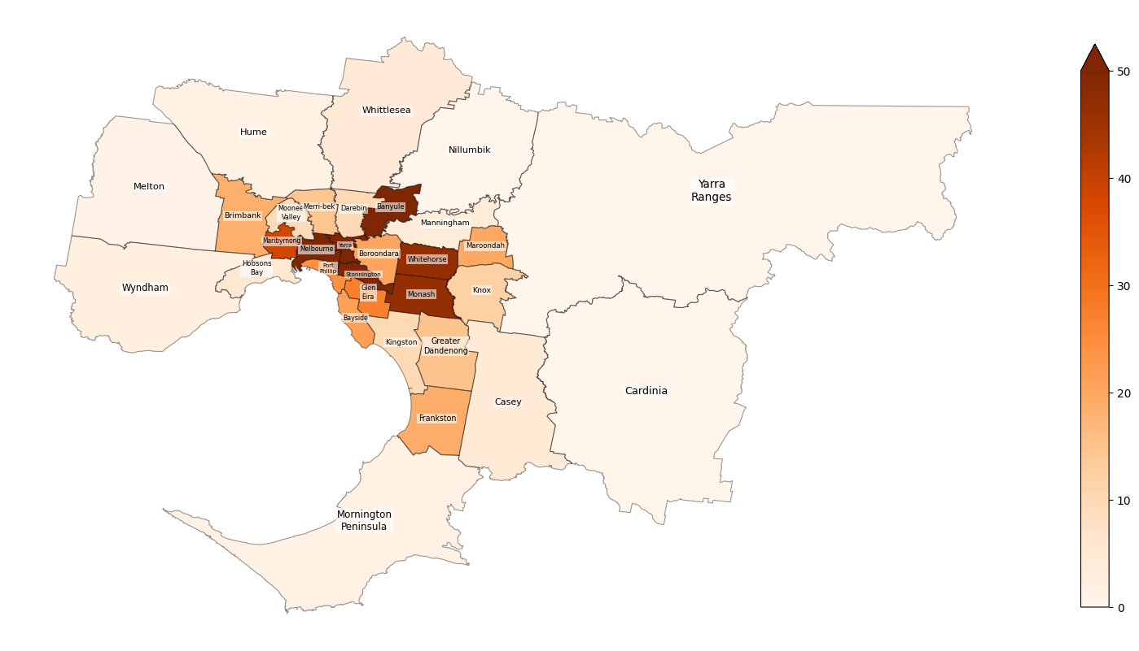
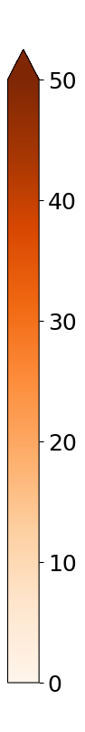
Where are the Nurses and Midwives working in Greater Melbourne?
Local Government Areas
Density of nurses and midwives per km²
+
Density of nurses and midwives per km²
Data from ABS (Australian Bureau of Statistics) 2021 Census, aggregated at LGA (Local Government Areas) level

Slide 3
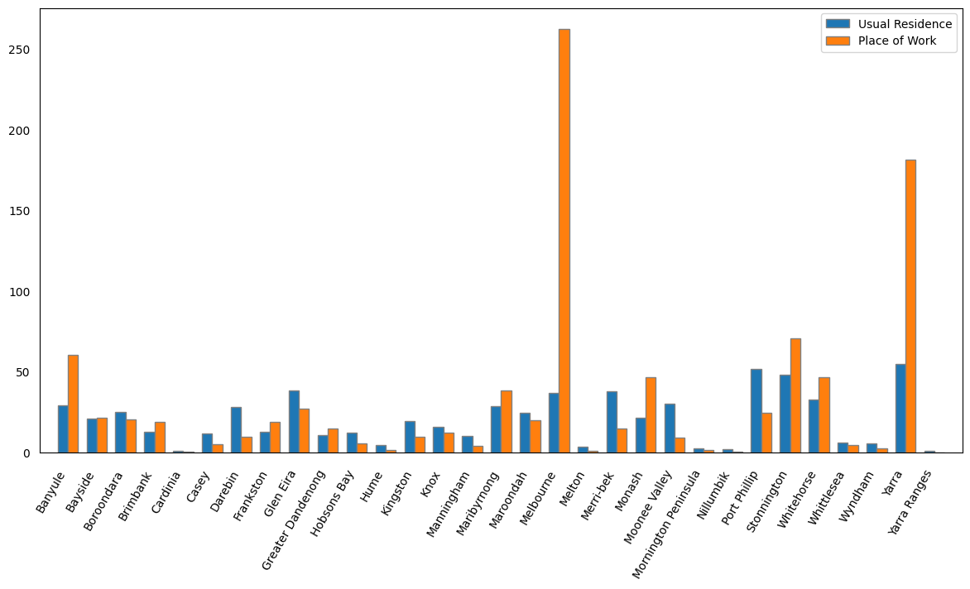
Comparison of usual residence and place of work of Nurses and Midwives
Density of nurses and midwives per km²
Local Government Areas
Data from ABS (Australian Bureau of Statistics) 2021 Census, aggregated at LGA (Local Government Areas) level

Slide 4
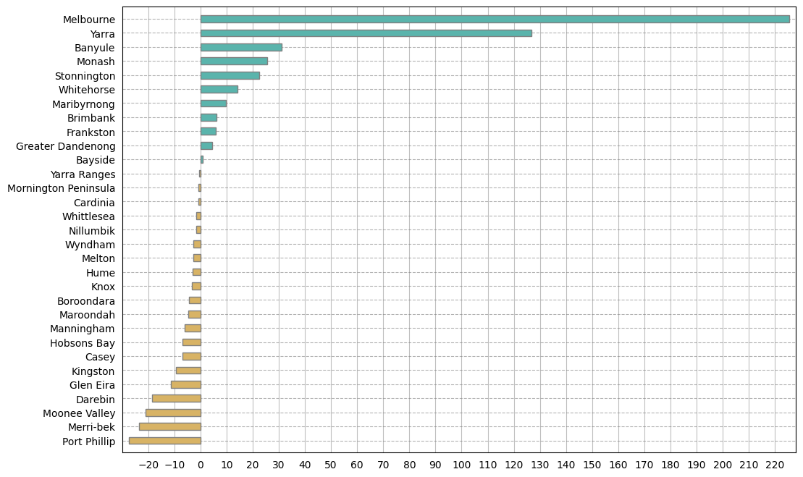
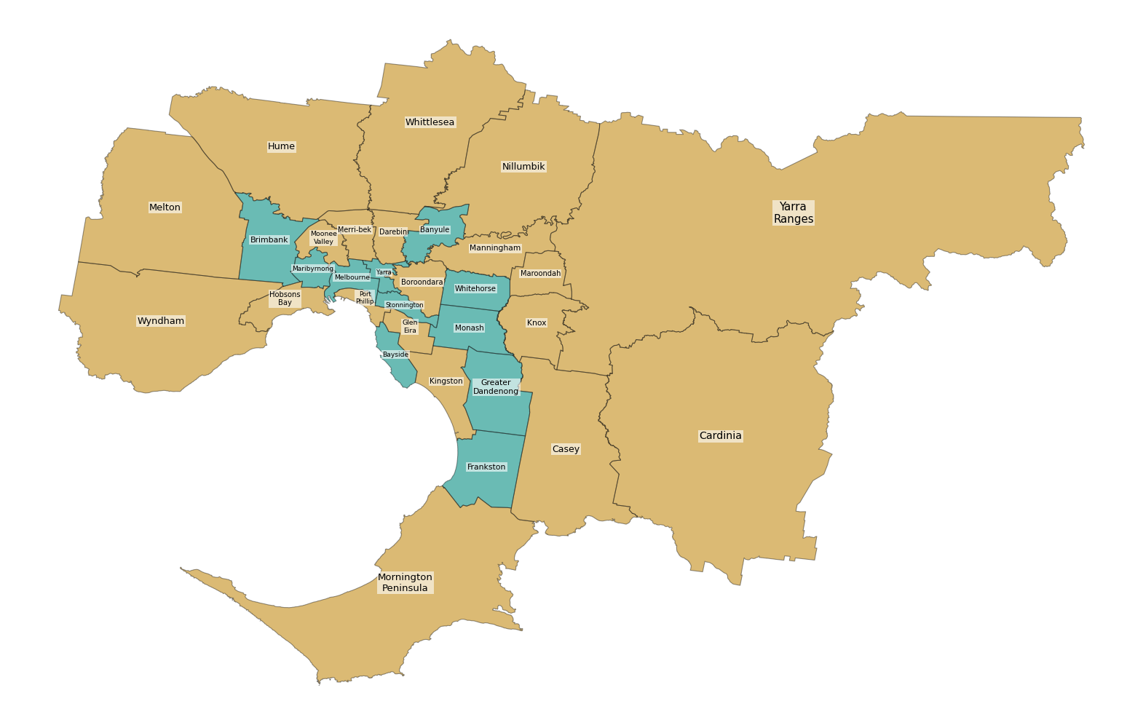
Which areas in Greater Melbourne do the Nurses and Midwives go more for work?
Local Government Areas
Net increase in density of nurses and midwives per km²
- More Nurses and Midwives are coming here for work
- More Nurses and Midwives are leaving here for work
Data from ABS (Australian Bureau of Statistics) 2021 Census, aggregated at LGA (Local Government Areas) level

Slide 5
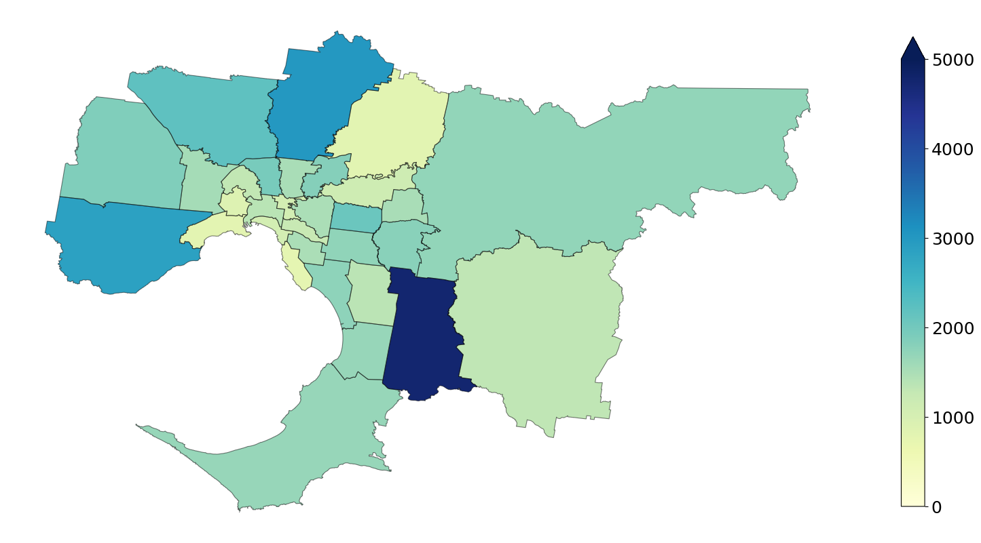
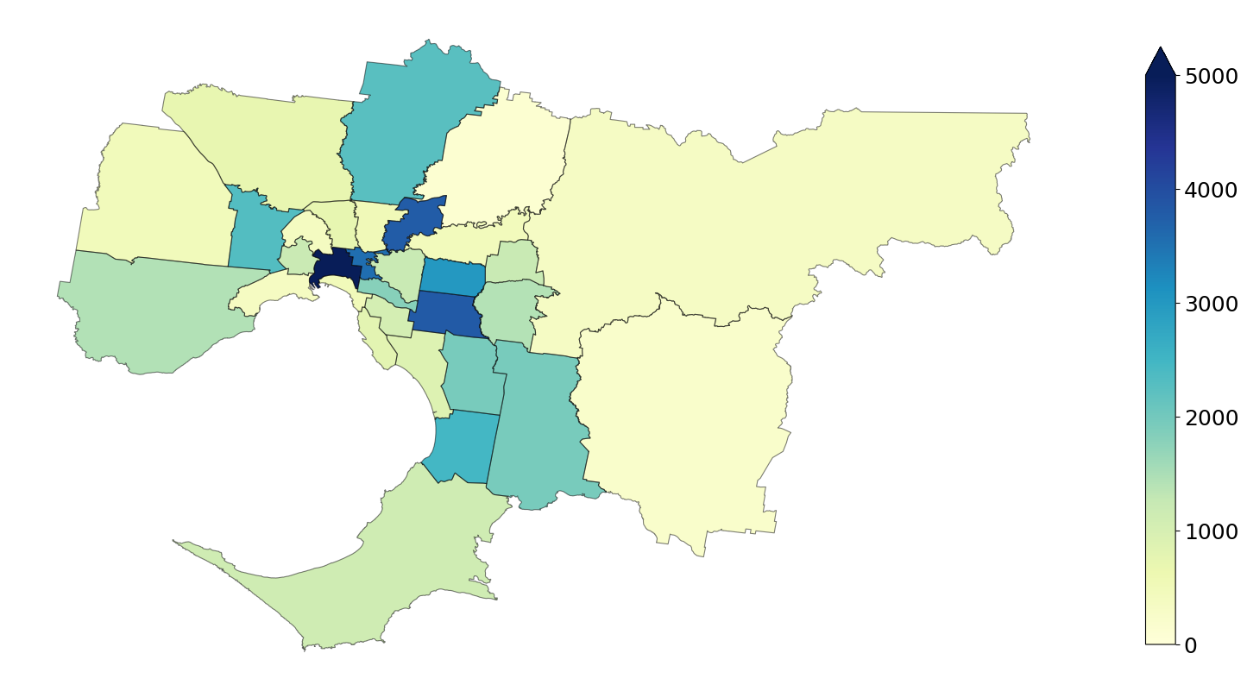
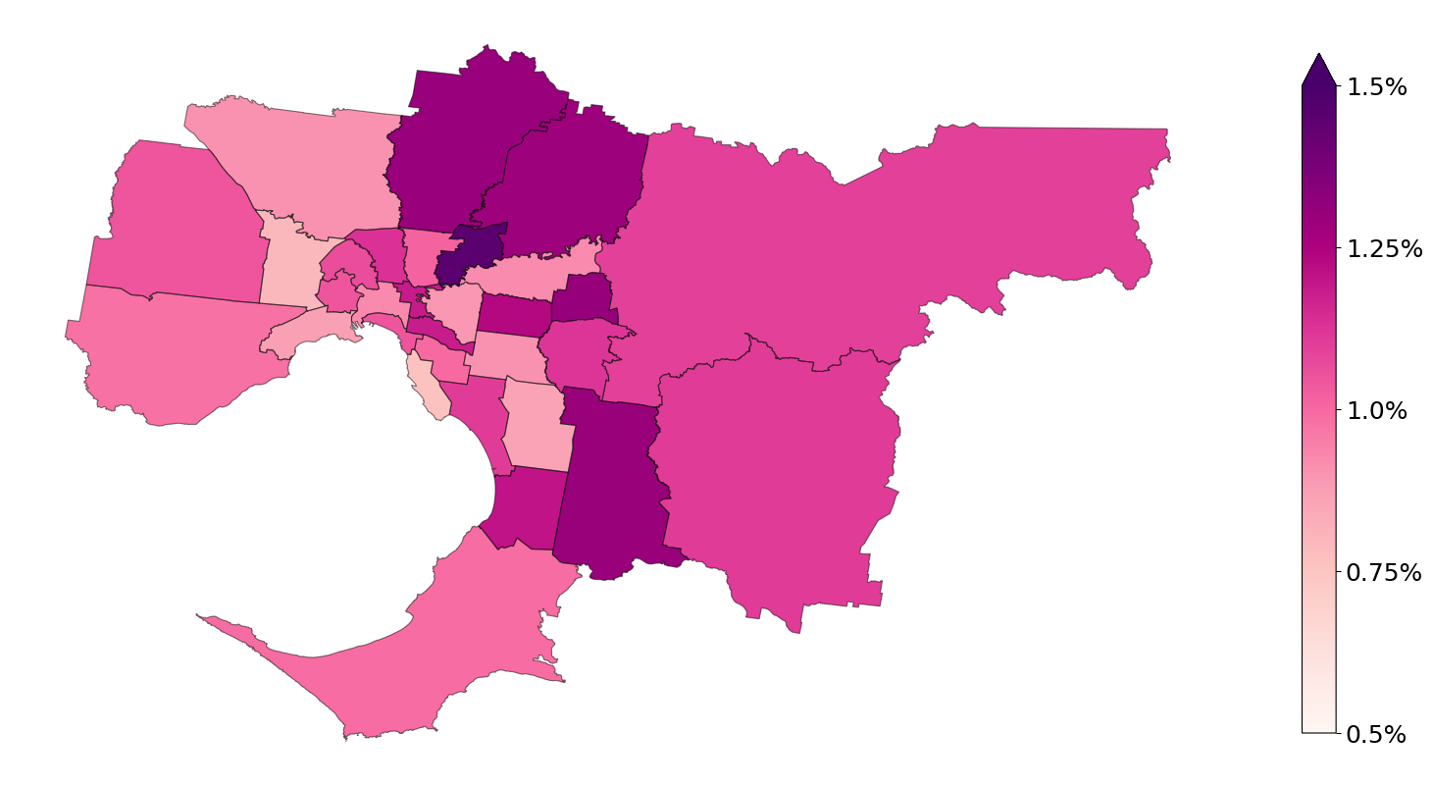
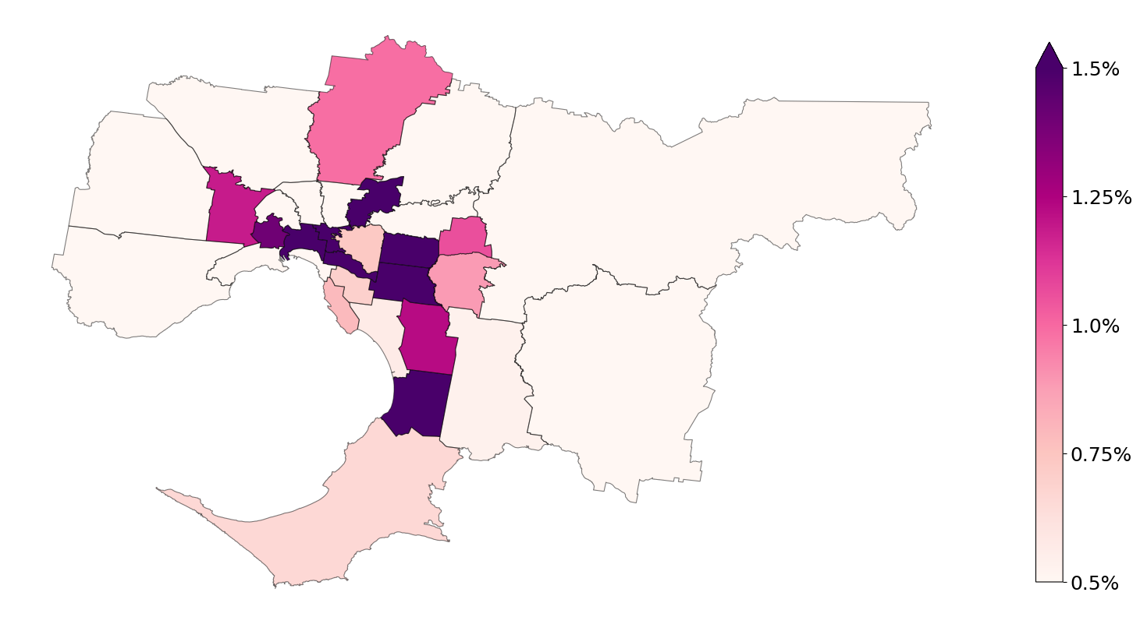
Nurses and Midwives count in Greater Melbourne
Number of nurses and midwives
+
Usual residence
Place of work
Nurses and Midwives–to–population ratio in Greater Melbourne
Number of nurses and midwives / Population
+
Usual residence
Place of work
Data from ABS (Australian Bureau of Statistics) 2021 Census and from https://en.wikipedia.org/wiki/Local_government_areas_of_Victoria, aggregated at LGA (Local Government Areas) level

